Slide 1



Slide 2
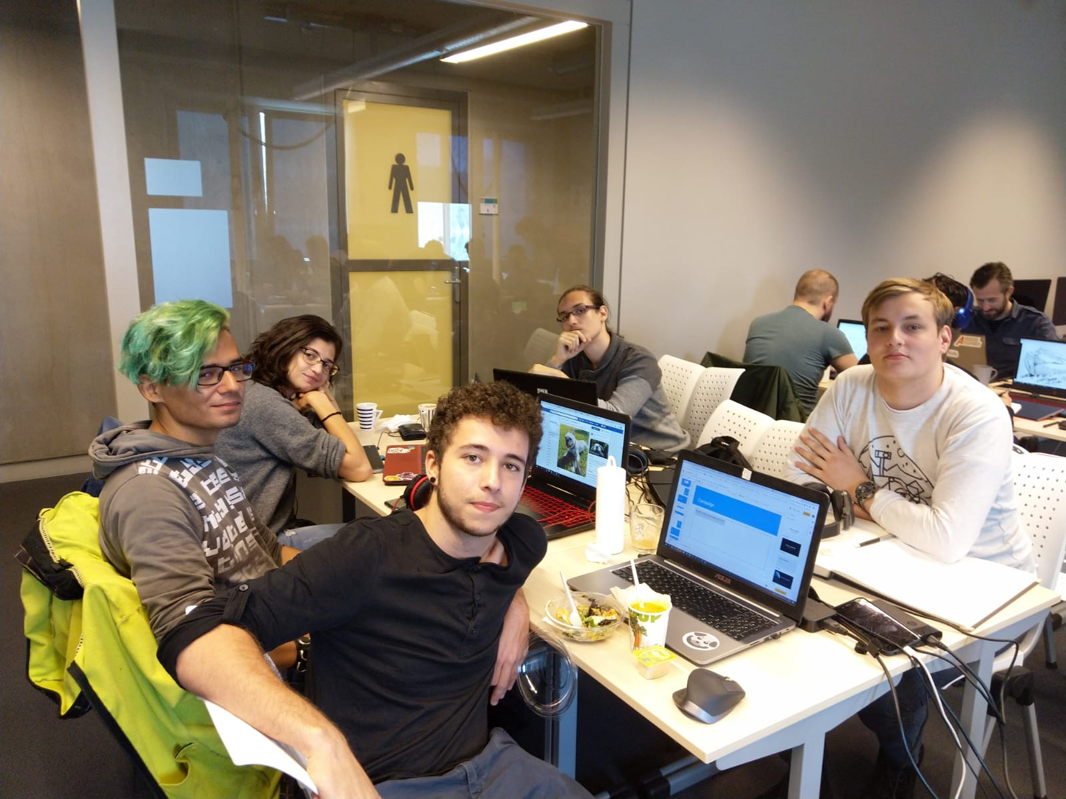
Team
Designer
Mihai Niculescu
Engineer
Arjen ‘Big Brain’ de Aldrey
Artists
Victor Start
Viktoria Minkova
Valentin Georgiev

Slide 3
Scrum planning

Slide 4
Researching concepts and Fleshing out designs.
Polishing game and Produce marketing items.
Week 1
Week 2
Week 3
Testing concept and Producing game.

Slide 5
Campaign
The Shelter Pet Project
“Our goal is to make shelters the first place potential adopters turn when looking to get a new pet, ensuring that all healthy and treatable pets find loving homes. We do this by breaking down misconceptions surrounding shelter pets and celebrating the unique bond between every shelter pet and parent.”

Slide 6
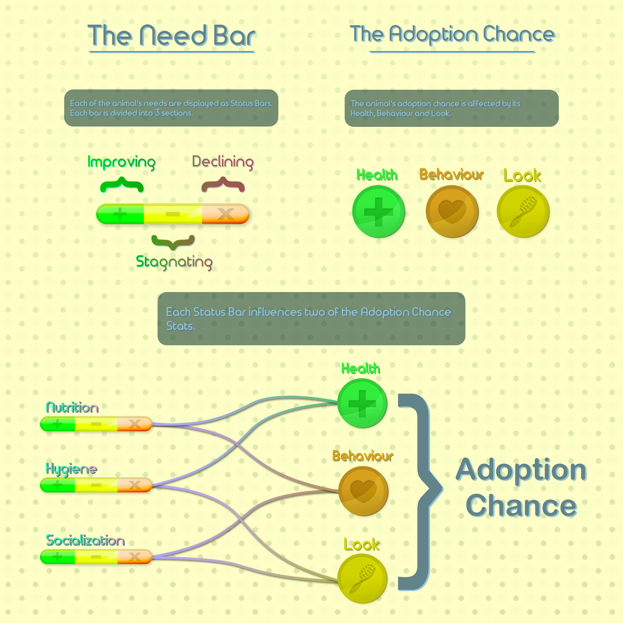
Game Rules

Slide 7
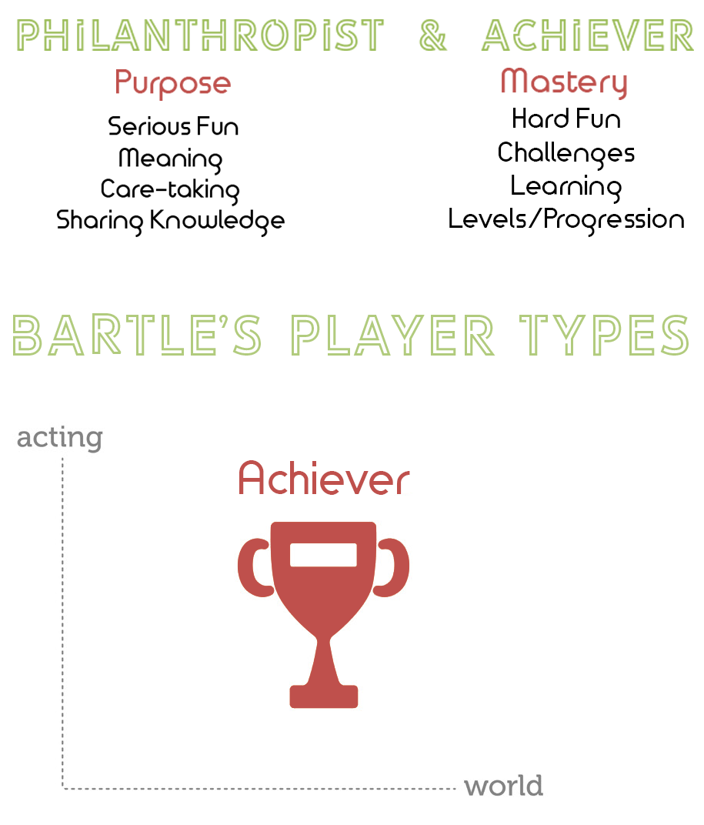

Slide 8
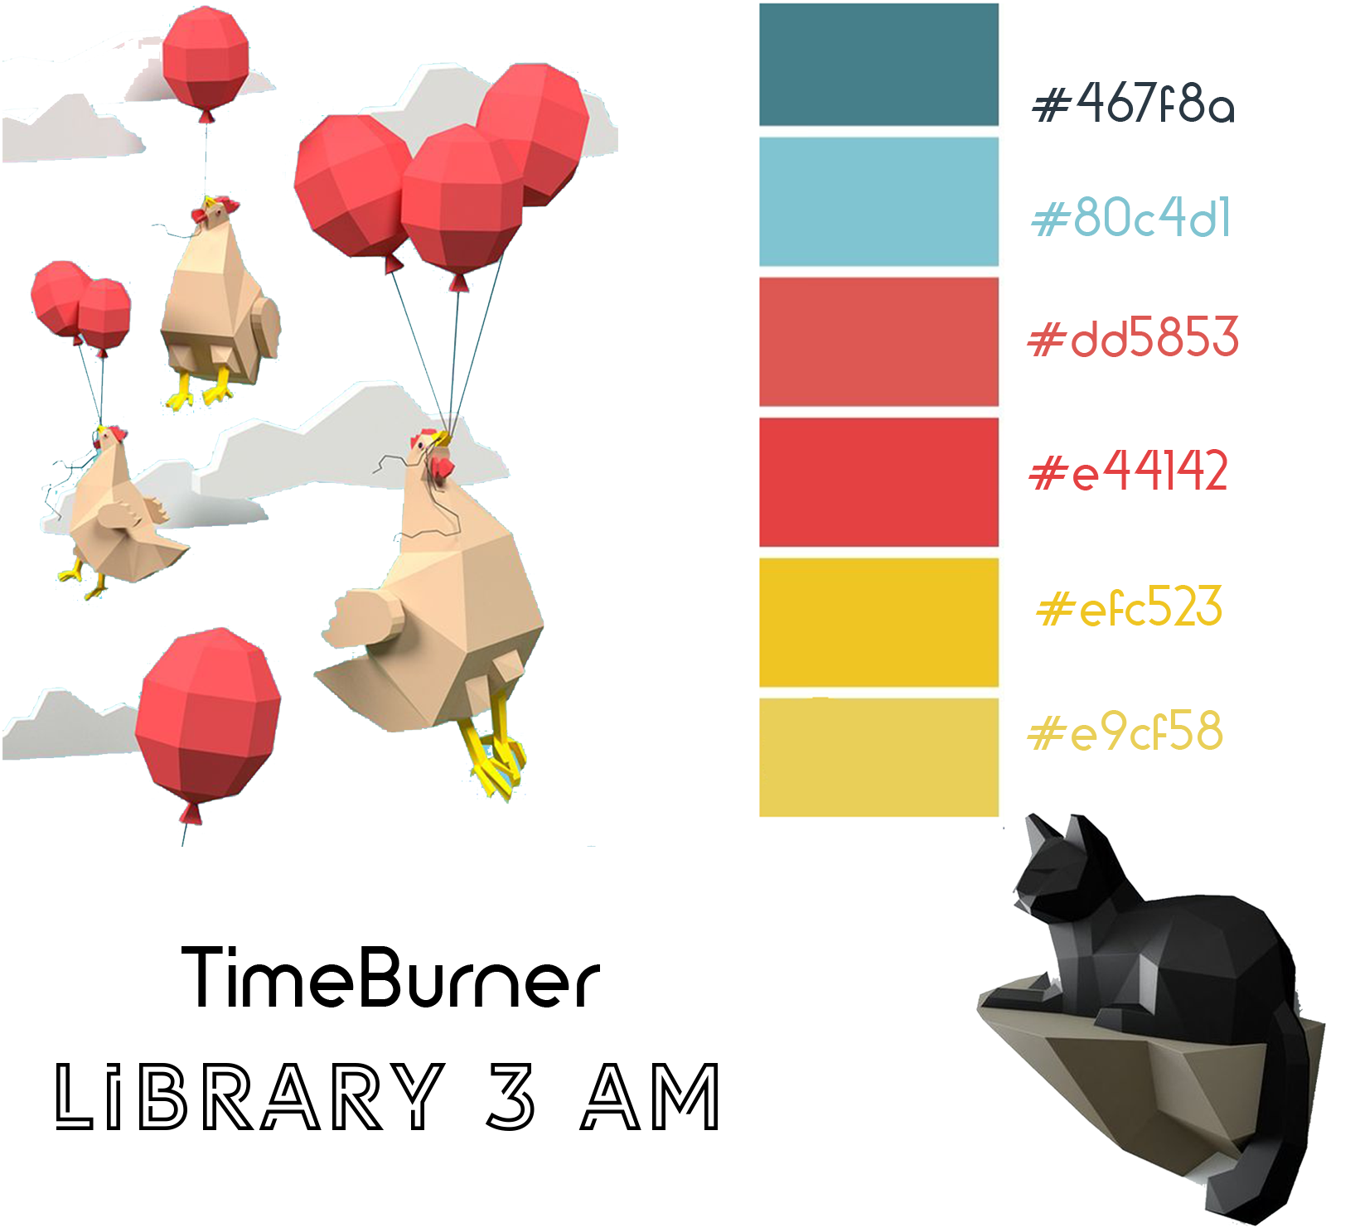
Style-sheet

Slide 9
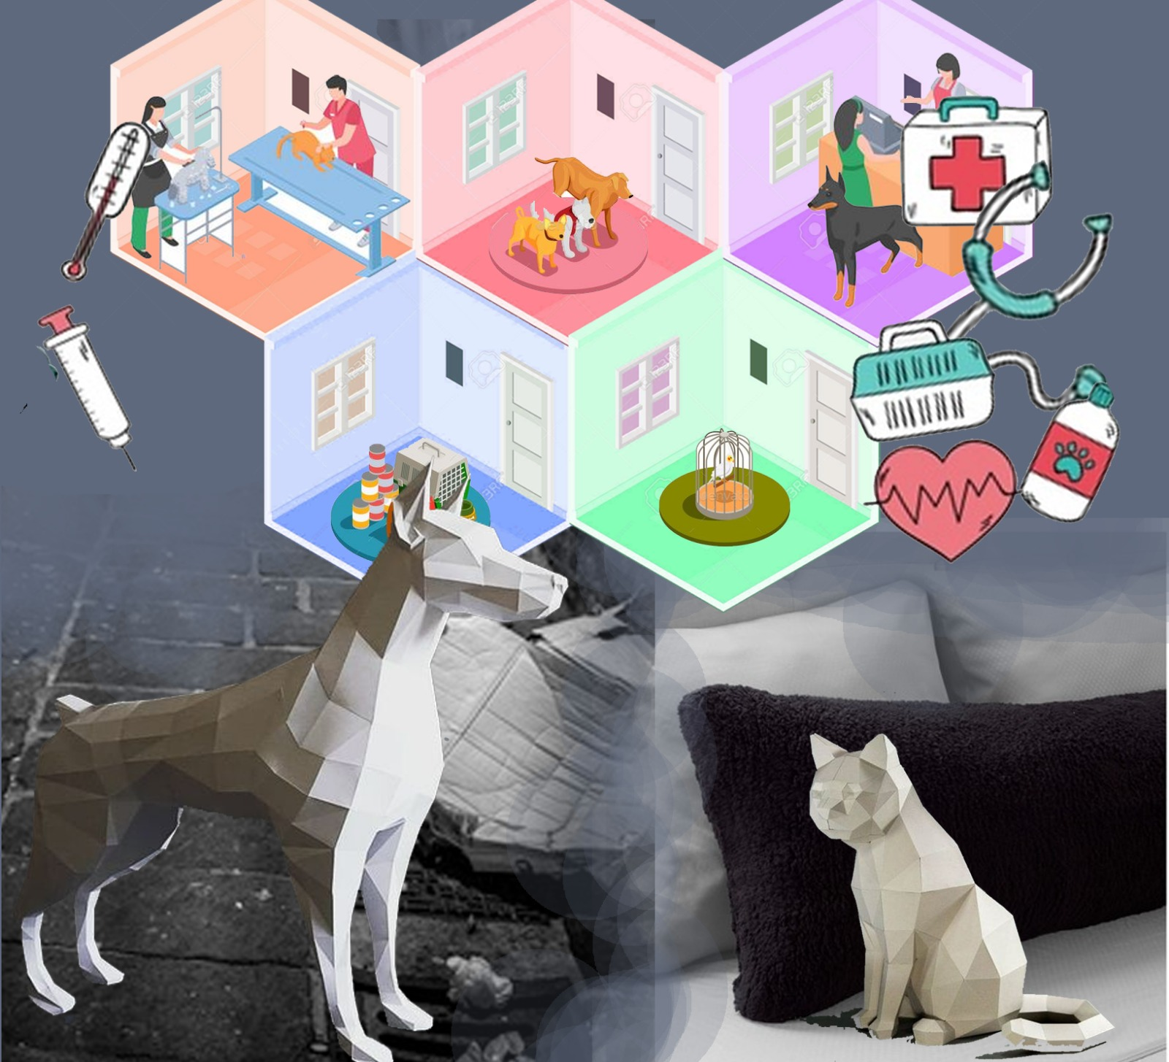
Moodboard

Slide 10

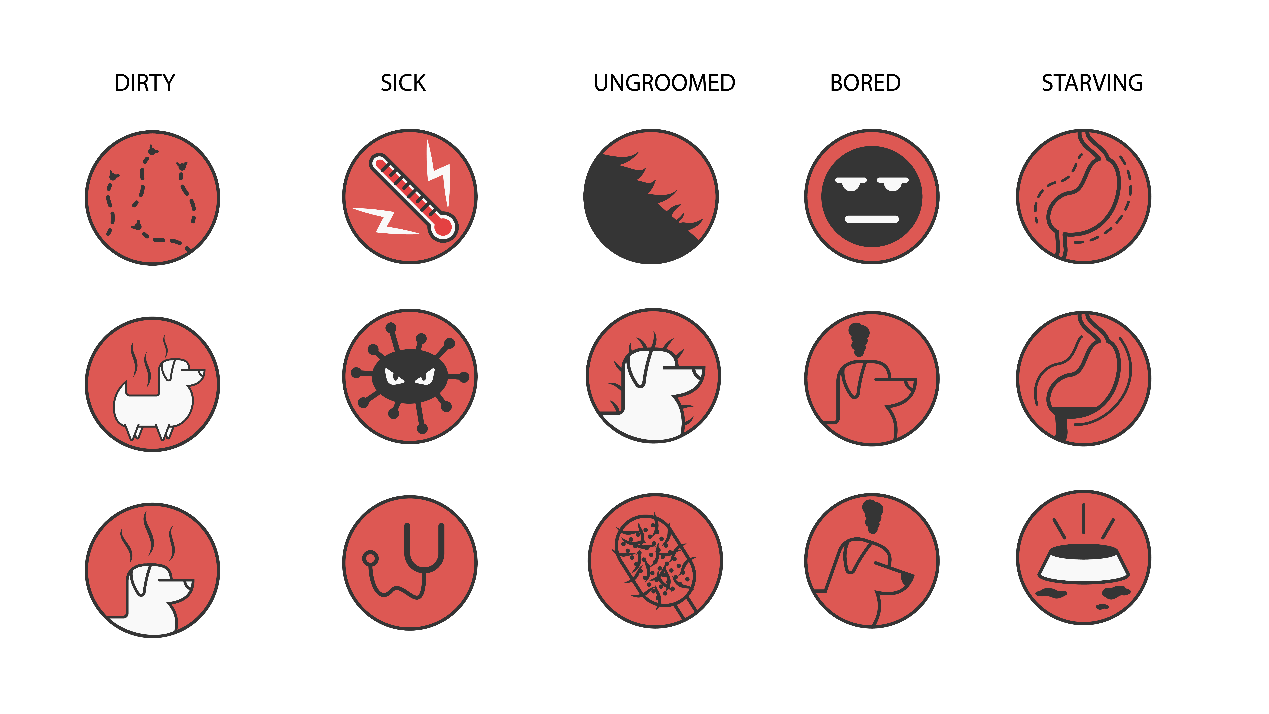
UI

Slide 11
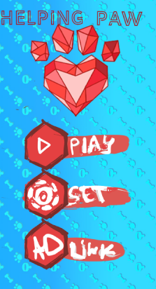
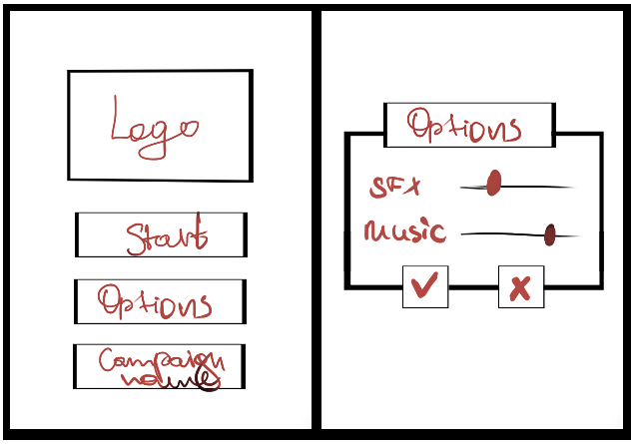

Slide 12
Assets

Slide 13
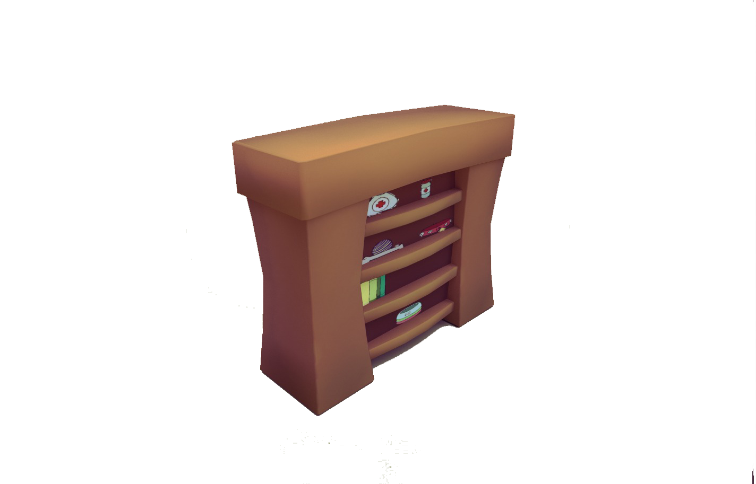
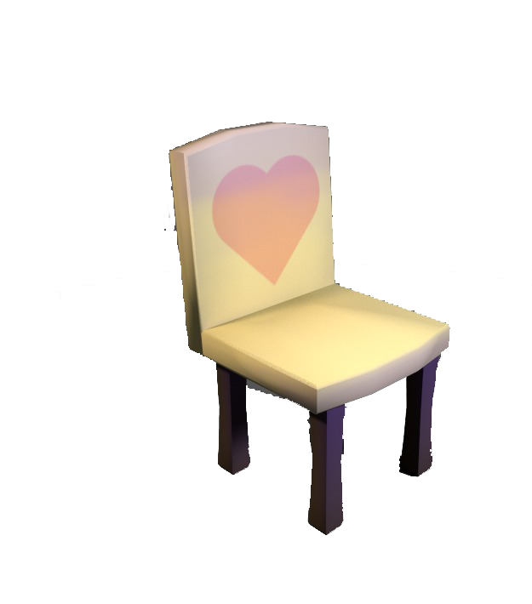
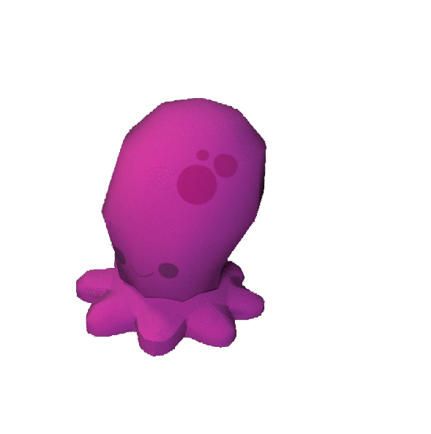

Slide 14
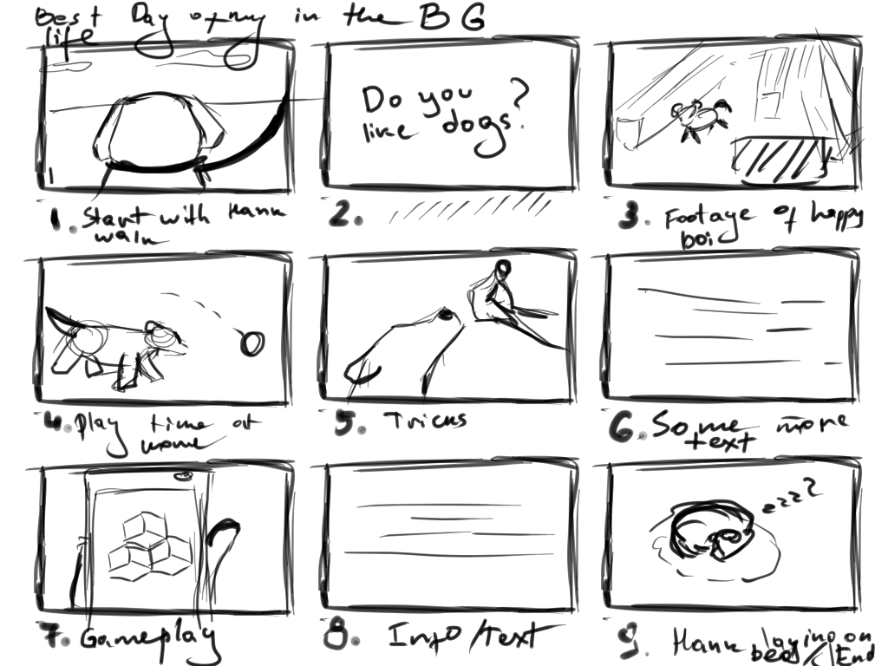
Storyboard

Slide 15
The end.
Questions?

